Slide 1
Laboratory Medicine APP - Update
Section on Lab Medicine Annual General Meeting
Adam Farber, Executive Vice President, EPR
Sep 26, 2025

Slide 2
Agenda
2021-24 PSA & LMFFA
Working Group Progress and Status
2024-28 PSA Year 2-4 Arbitration Brief
Next Steps
Q&A

Slide 3
2021-24 PSA Negotiation

Slide 4
2021-24 PSA Negotiation
June 2020, call for proposal to the sections
August 2020, lab proposal submitted by the section
Aug – Oct 2020, consultation with lab med executives in following up with the proposal
Oct 2022, PSA negotiations start
April 2021- Feb 2022, PSA mediation
March 2022, ratification townhalls
March 28, 2022, agreement is ratified
Through the above processes, NTF, OMA staff and the section executive successfully advocated for lab APP to be included in the PSA.

Slide 5
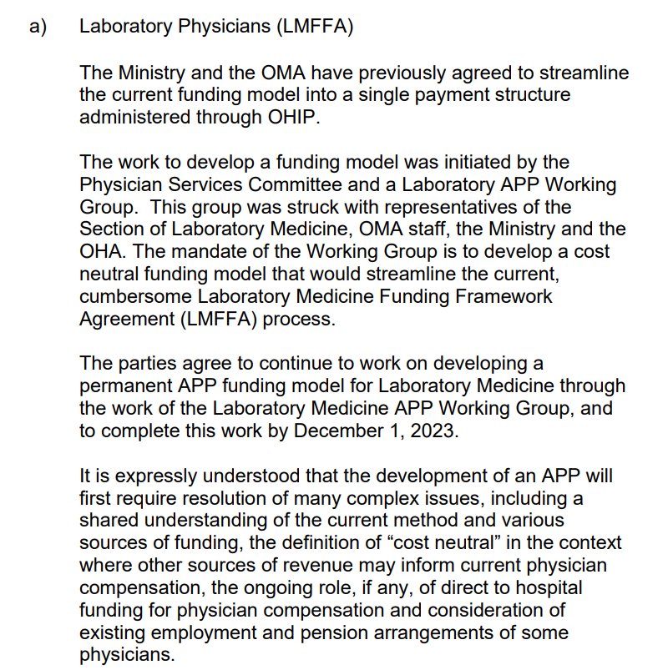
LMFFA on 2021/24 PSA
Streamlining the current dual funding into a single stream funding model as a key first foundational step
Recognition that the current LMFFA funding mechanism needs to be reviewed and modernized
Bilateral lab APP working group was struck to establish a permanent APP
Mandate was to develop a cost neutral funding model that would streamline the current LMFFA process
Both parties agreed streamlining would be the crucial first step

Slide 6
Lab Medicine APP Working Group

Slide 7
Lab APP Working Group – Progress
Bilateral group was struck in Nov 2022, with intended completion by Dec 2023
Accomplishments to-date:
  Launched, conducted and reviewed the provincial environmental scan
  Agreement on several key elements of the proposed APP
  Engaged key external stakeholders
Complexity of the work resulted in the group requesting subsequent extensions in 2023-2025

Slide 8
Lab APP Working Group – Current Status
Bilateral work was briefly paused but has now resumed
Most recently, the OMA has put forward our position on several key elements and are currently awaiting MOH response
It was recognized the current mandate of the working group is too narrow to achieve the overarching goal of the section, but would serve as a primer for future negotiations

Slide 9
2024-28 PSA Negotiations

Slide 10
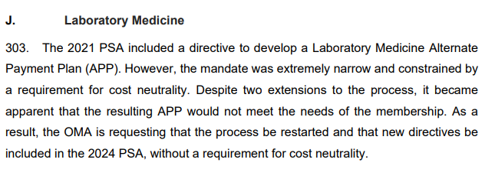
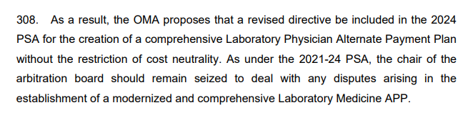
Arbitration Brief – Year 2-4
The OMA arbitration brief for 2024/28 years 2-4 called out the need for a comprehensive APP without the restriction of cost neutrality.
Award was announced on Sep 18 with $120M investment awarded for new and expanded APPs in the province, including lab physicians.

Slide 11
Nex Steps

Slide 12
Next Steps
The Arbitrator's ruling determined the quantum normative and targeted increases for year 2-4
The OMA remains committed to establishing an APP model that meets the needs of the membership.
Section executives will continue to be involved in the APP work and OMA’s advocacy efforts.
Other venues to advocate will continue to be explored
Concrete next steps outlined in the next slide

Slide 13
2025-2027 Lab APP Workplans
Step 1: Streamline Current Funding Model and APP Development (December 2025)
Step 2: Burden Based on Call System (December 2025)
Step 3: Negotiation for funding increases for the new APP in the new PSA (2024-28)
Step 4: Development of Workload Metrics (December 2026)
Step 5: Negotiation for Funding Increases and APP Augmentation (2027)
Step 6: Opportunities outside the PSA cycle

Slide 14
Q&A

